Slide 1

Welcome
Software Engineering Lab CSE-0318
Name: Shubho Chandra Shil
ID: UG02-48-18-021

Slide 2

CLASSROOM MANAGEMENT

Slide 3
Overview
What is Classroom Management
Why Classroom Management
Principles of Classroom Management
Components of Classroom Management
Strategies for Classroom Management
Key dimensions of Classroom Management
Classroom Norms
Components of Classroom Norms

Slide 4
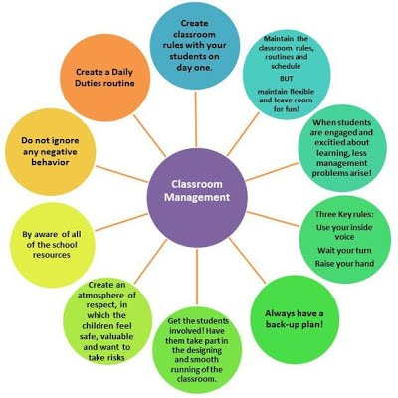
What is Classroom Management?
Classroom management is creative: It creates both the best situation in which the students can learn and the teacher can teach.
Procedures and instructional techniques that are used to establish the classroom environment so that learning can occur.
Management strategies are based on understanding how the classroom environment can.

Slide 5

Why Classroom Management?
Primary Purpose is to gain control of the classroom
Good classroom management results in high levels of student engaged time.
To provide a conducive learning Environment to the learners.
Best utilization of Classroom time.
Social Development by inculcating social skills.

Slide 6
Principles of Classroom Management
Brophy (1983) states there are 3 general principles for good classroom management:
Willingness of the teacher to accept responsibility.
Long-term, solution-oriented approaches to problems (rather than short-term)
Check to see if symptomatic behavior is caused by underlying personal problems ( impulsivity, lack of awareness, home problems etc.) desist/ control responses classroom control

Slide 7

Components of Classroom Management
Seating
Displays
Individual Attention
Pair & Group Work
Cleanliness
Usage of Resources
Timetable
Classroom Norms
Teacher’s Movement
Use of Black Board
Evaluation
Observation
Questioning
Demonstration & Presentation
Social Skills
Accessibility
Pair/Group Composition
Instruction
Body Language

Slide 8
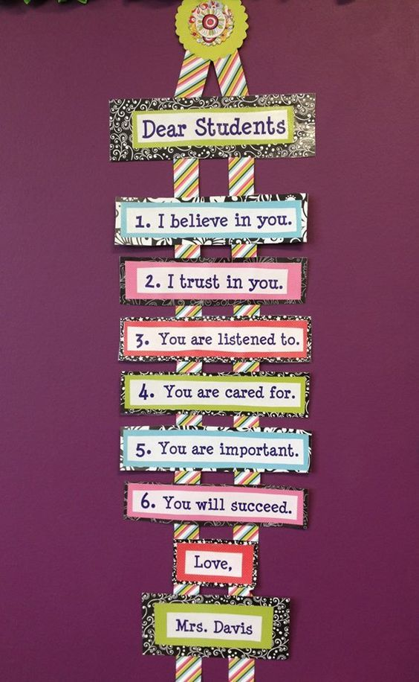
Strategies for Classroom Management
Planning
How to achieve desired goal
Organization
Rules and procedure should be aligned with teaching strategies
Communication
Communication should be effective
Motivation
Create a learning environment that encourage social interaction.
Monitoring
Monitoring the activities

Slide 9

Key Dimension of Positive Classroom Management
Physical Dimension
Condition of furniture
Place to keep things
Proper place to sit for students
Light, vision possibilities
Noise level
Temperature of the classroom
Right place for chalk board or bulletin board.
The Ambience(Environment)
Odor
Humidity
Chalk dust
Heat-Cold
Noise-Echo-Quiet
(Each room has it own “Feel” and that ‘feel sends an Immediate message……air freshener, flower)

Slide 10
What are Classroom Norms?
Classroom norms are the behavioral expectations & rule of the class
Classroom norms tell us how we are expected to behave toward the material we use in school
It helps to ensure that students indeed understand the classroom and community’s expectations and expectation of class teacher

Slide 11
Components of Classroom Norms
Students will work together for common goal
Strong relationship b/w teachers & students
Active participation in classroom activities
Learning related mistakes are ok
Non-verbal warning (finger on desk )
Verbal warning
Written warning (on White/Blackboard)
Learning related mistakes are ok.

Slide 12


Thank You For Watching

